Slide 1


Slide 2
Team ID: GEN_017
Bassant Hossam
Aya Usama
Hossam Hatem
Omar Khaled
Usama Alaa
Team TA: Walaa Samir
Karim Mohamed
ID: 20201701232
ID: 20201700170
ID: 20201701235
ID: 20201700534
ID: 20201700105
ID: 20201700608

Slide 3
Project Requirements
The user can switch between sell or buy products In The Same Run.
More than seller and customer can register.
The Seller can: - Register by entering his information (name, email, …). - login using Email. - Add product and determine its category and quantity .
The Customer can: - Register by entering his information (name, email, …). - login using Email. - Browse products by its category, or name. - Add product to his cart if this is available.
- checkout.
Usage files and suitable data structures.

Slide 4
Project additional features
For any user :
Sort the products in any category by rate, name, price.
For any seller :
The seller can view his history wallet.
Show his feedback page.
The seller can search on any product by its name.
For any customer :
Show the delivery date for each product.
Show feedback page for product, and seller.
Add product to favorites & show favorites page in his profile.
Can view the seller profile, his available products on the market, and his feedback.

Slide 5
MVC Pattern

Slide 6
Model, View, and Controller Connections

Slide 7
Home Page

Slide 8
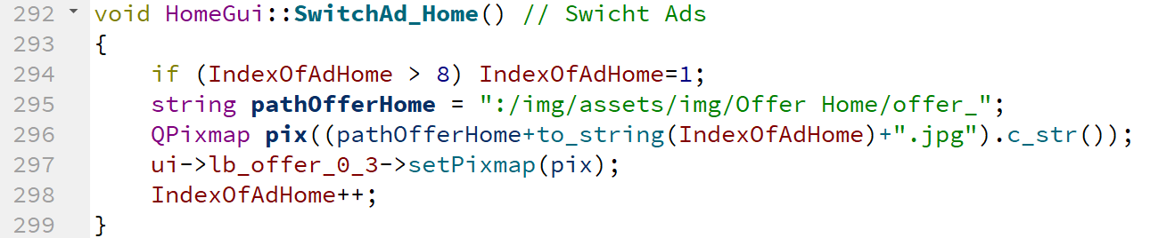
Switch Ads function

Slide 9
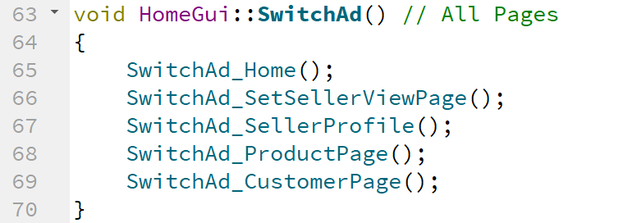
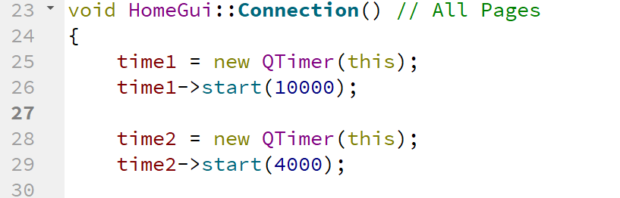
Its Connection

Slide 10
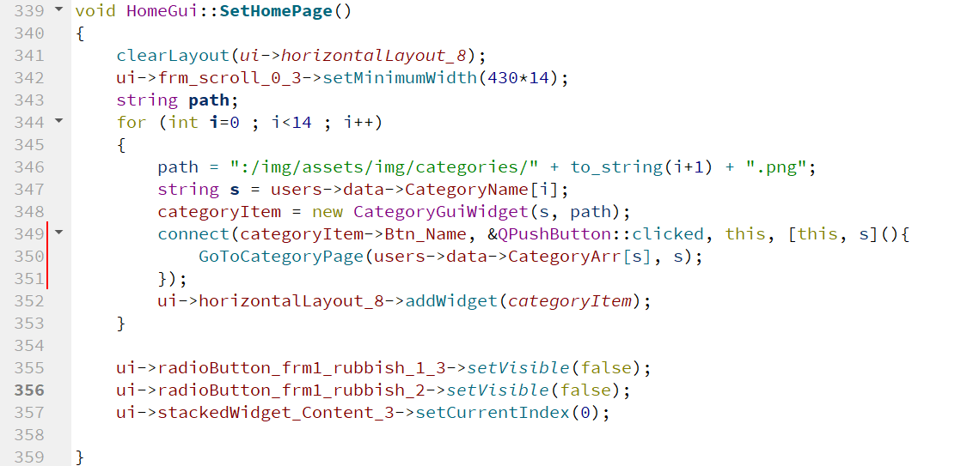
Home page setup

Slide 11
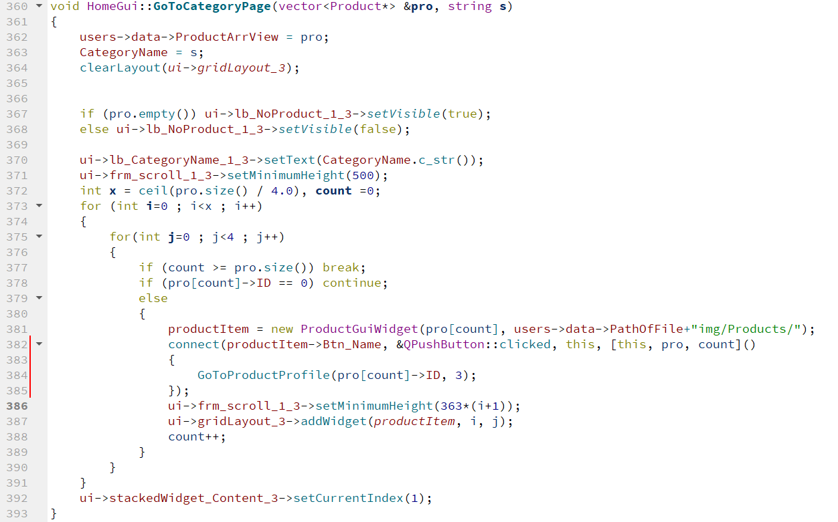

Slide 12
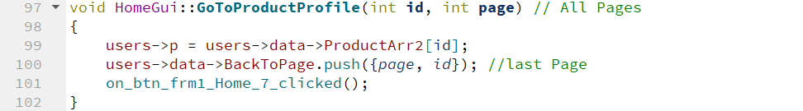

Slide 13
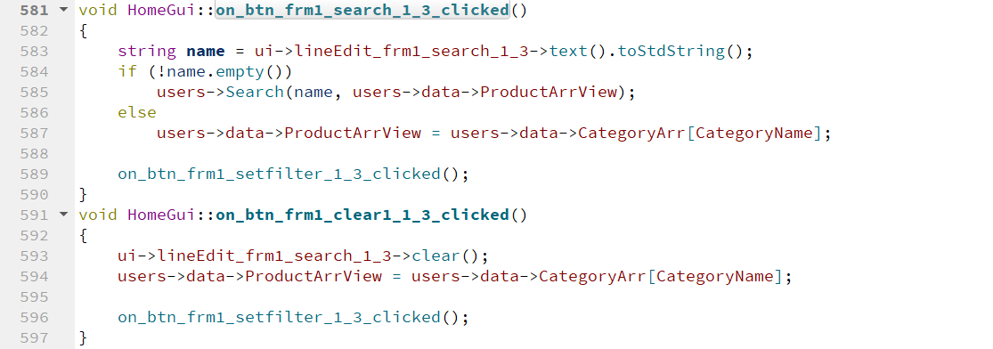

Slide 14
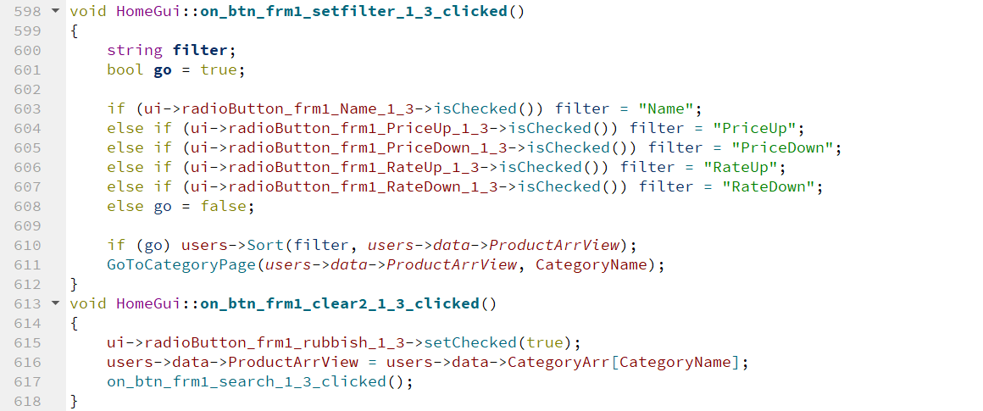

Slide 15
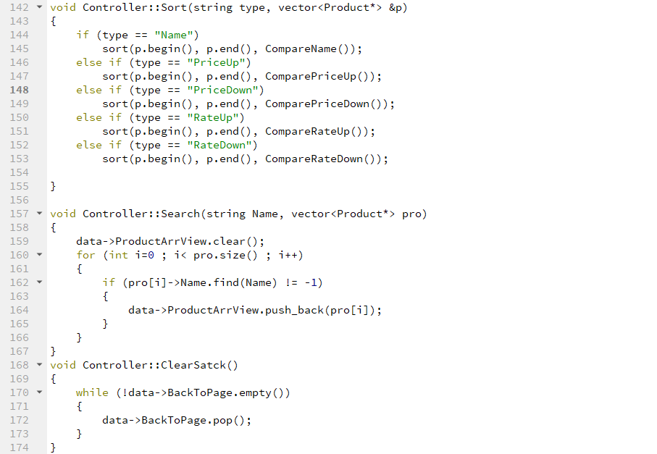

Slide 16
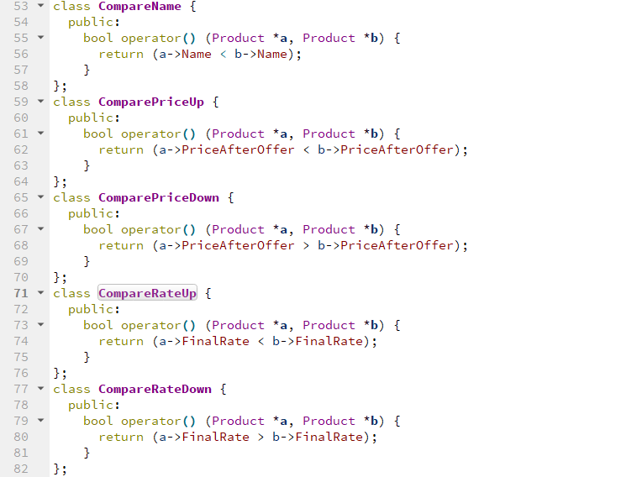

Slide 17
Product page

Slide 18
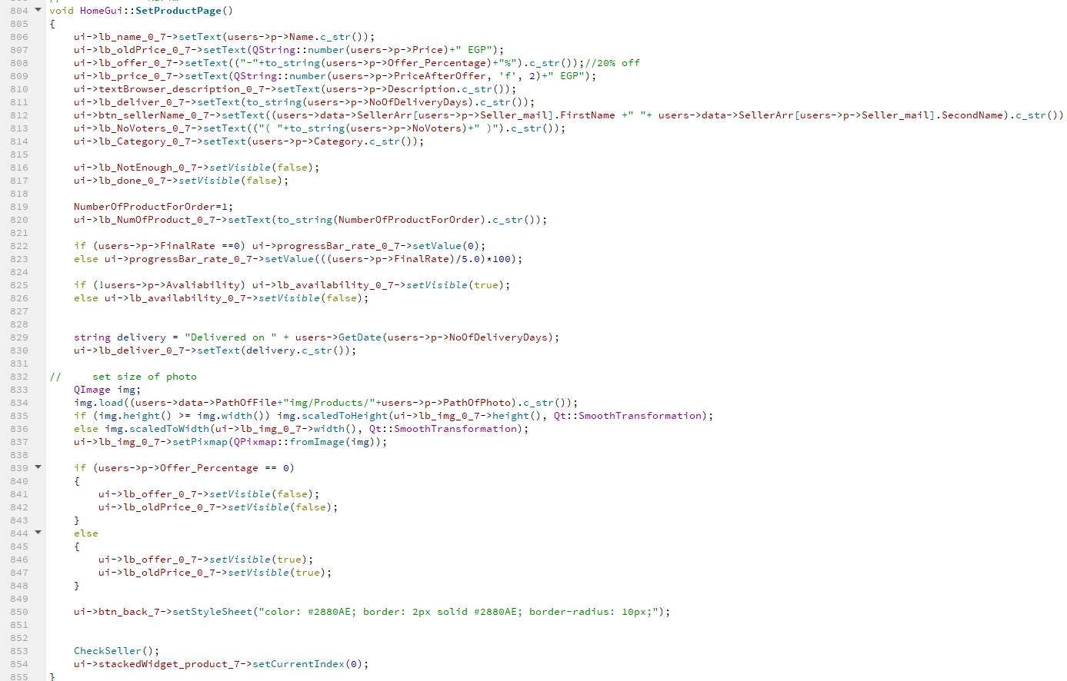

Slide 19
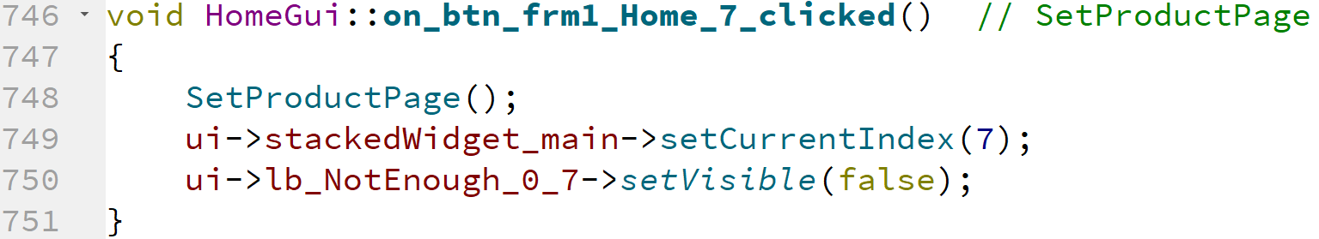

Slide 20
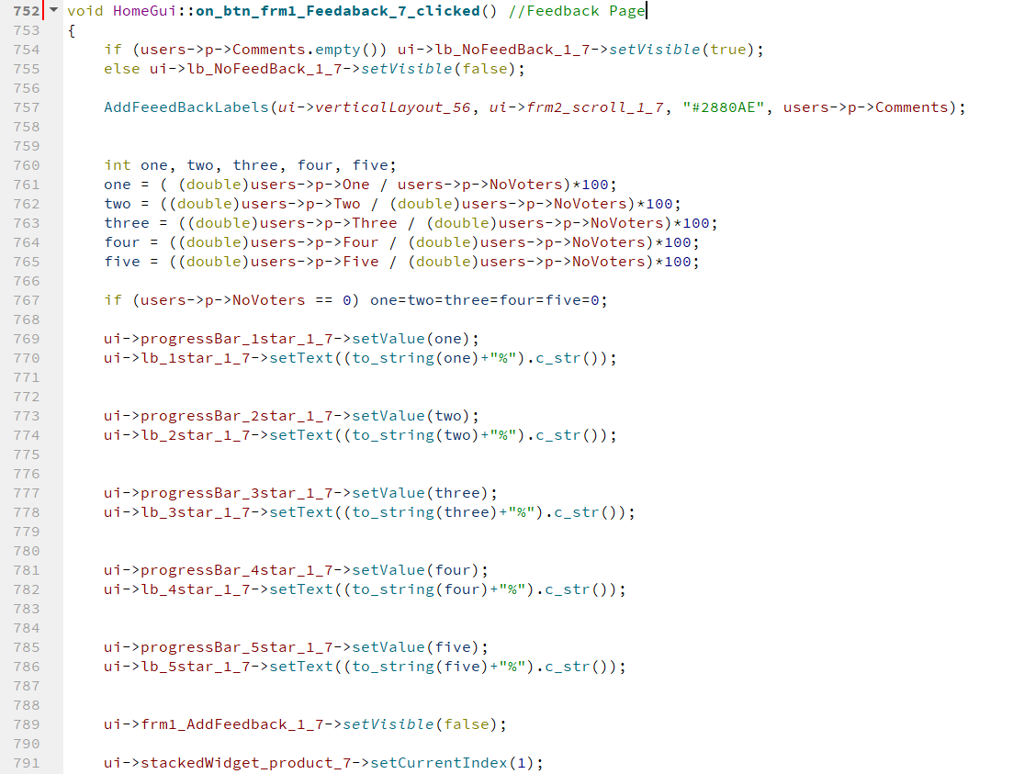

Slide 21
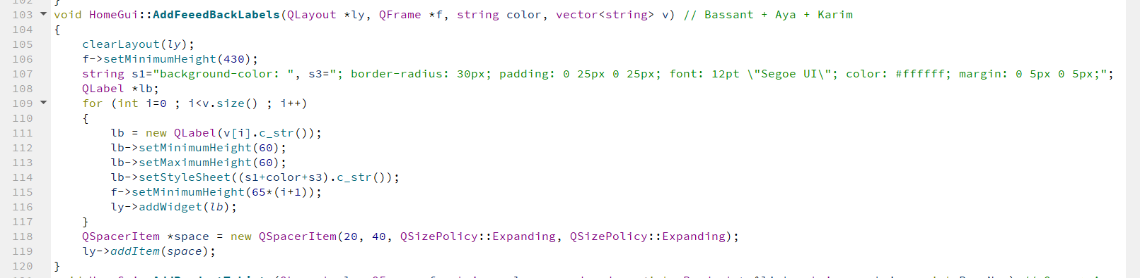

Slide 22
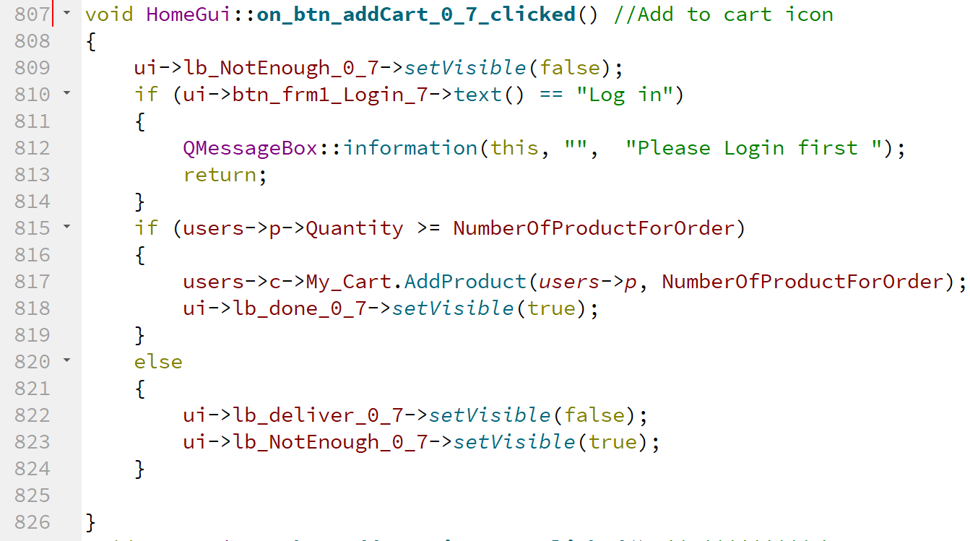

Slide 23
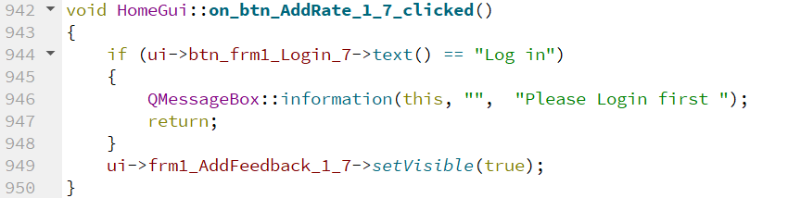

Slide 24
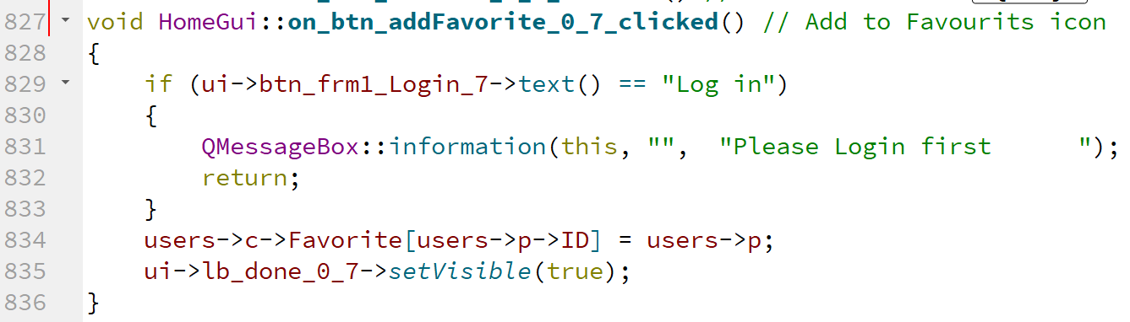

Slide 25
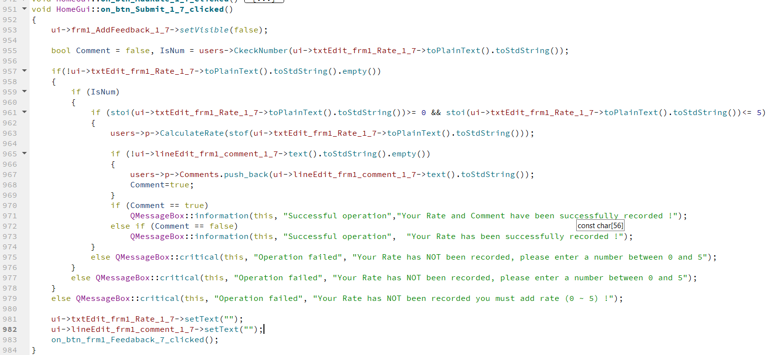

Slide 26
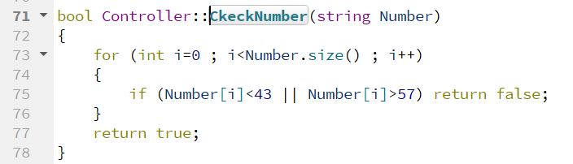

Slide 27
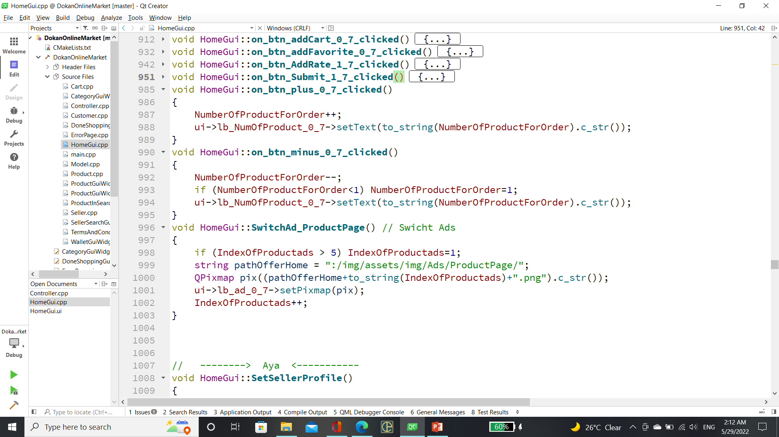

Slide 28
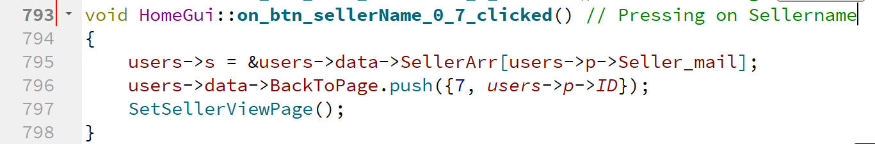

Slide 29
Seller view page

Slide 30
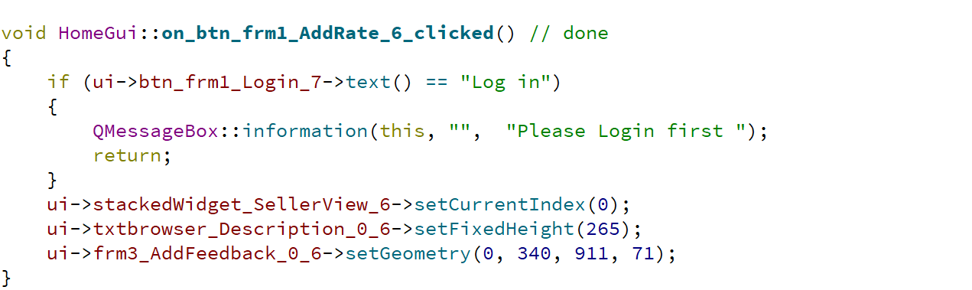

Slide 31
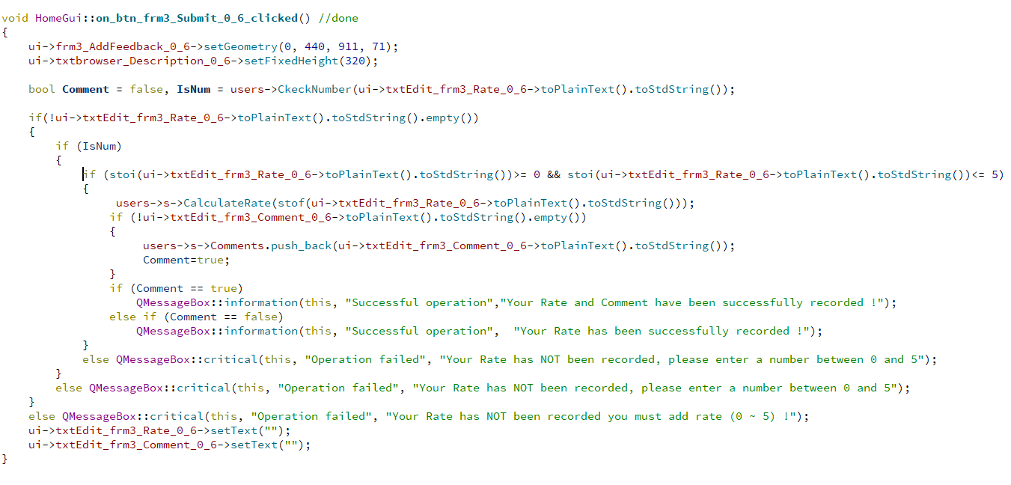

Slide 32
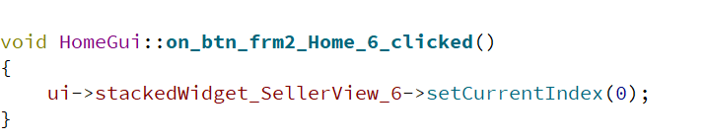

Slide 33
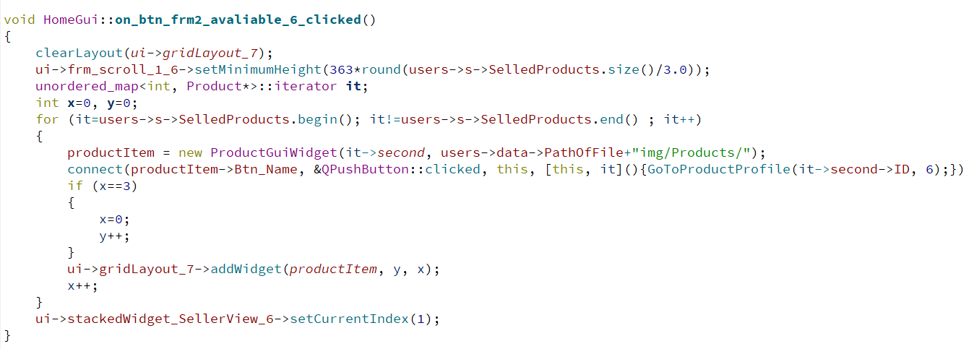
Available product button

Slide 34
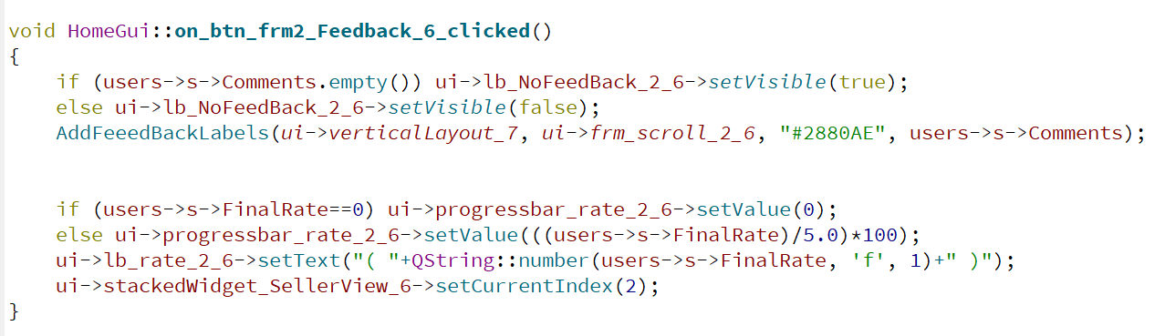
Add Feedback

Slide 35
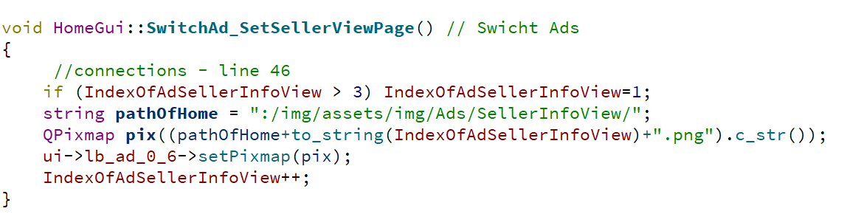
Switch Ads function

Slide 36
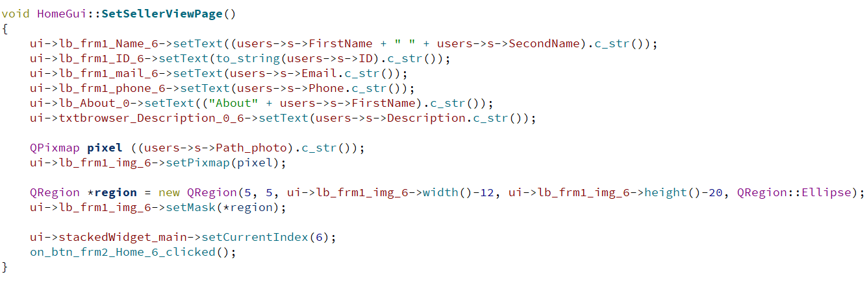
Set Seller View Page

Slide 37
Seller Search function

Slide 38
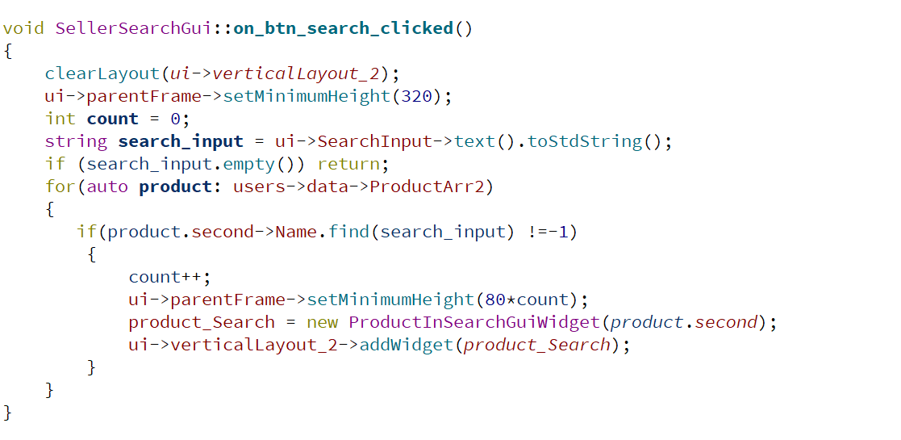
Seller Search function

Slide 39
Customer page

Slide 40
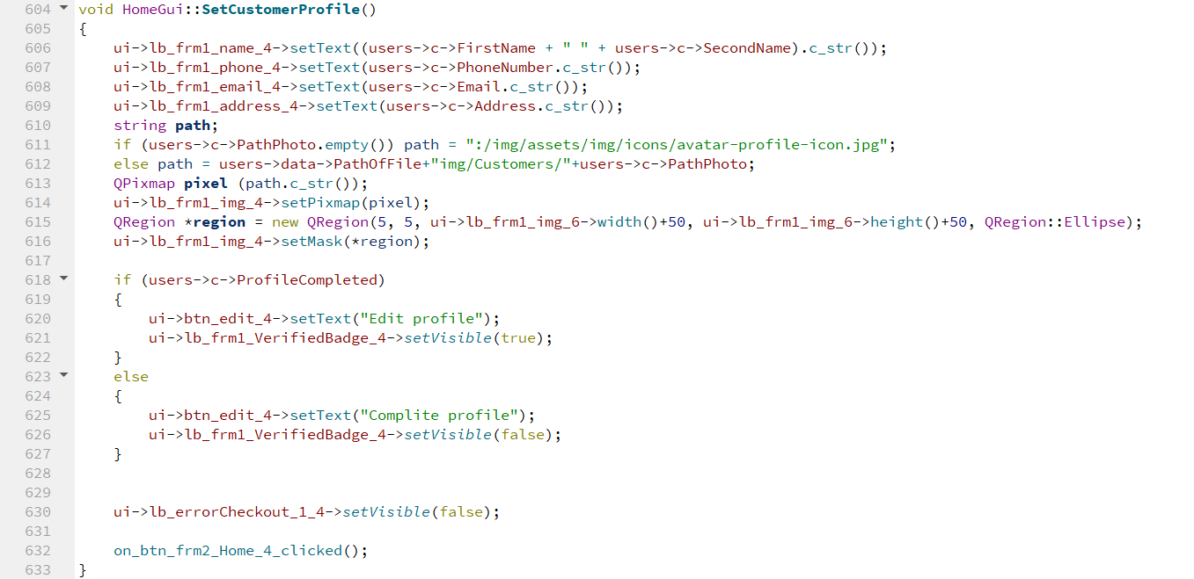
Customer Profile

Slide 41
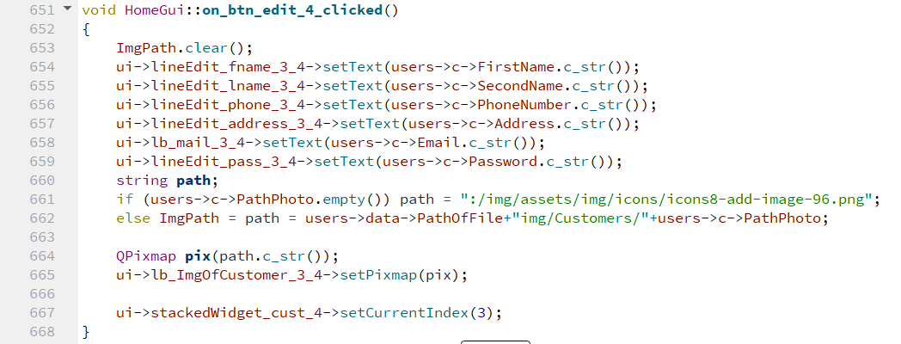
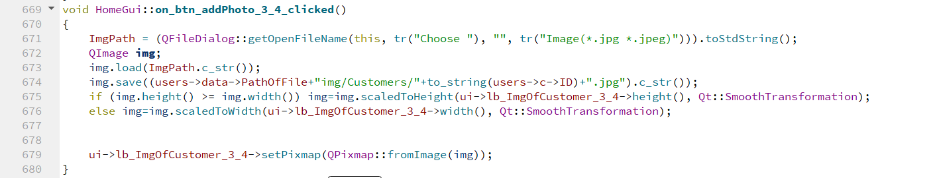
Edit Profile

Slide 42
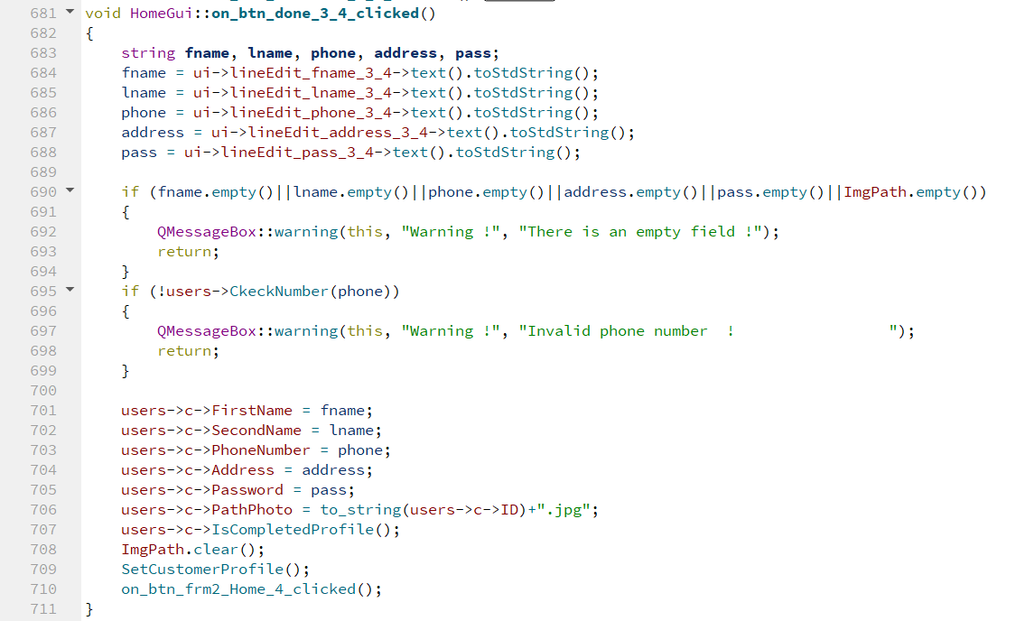
Edit completed

Slide 43
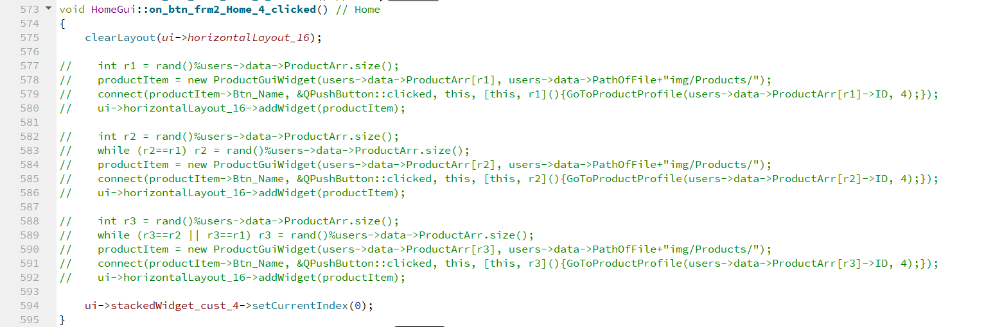
Customer Home Page

Slide 44
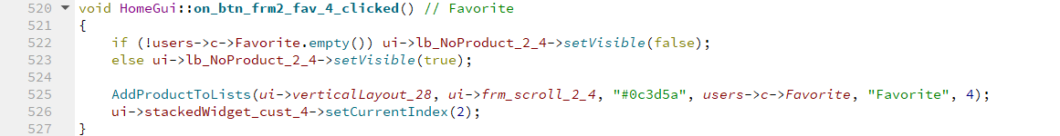
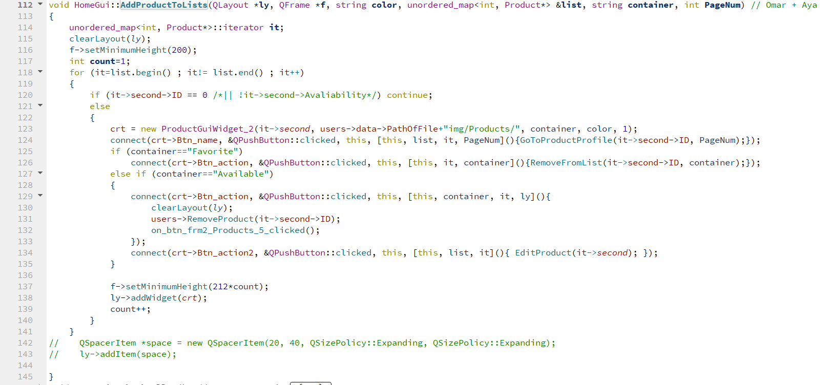
Favorite Page
____________________________________________________________________________________________________

Slide 45
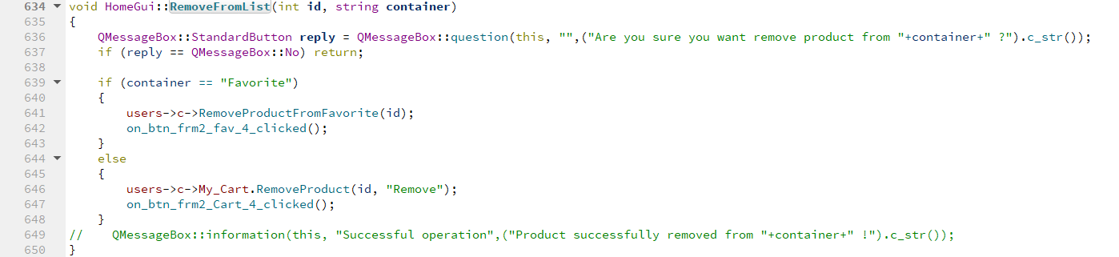
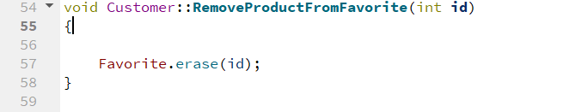
Remove from list
Remove favorite

Slide 46
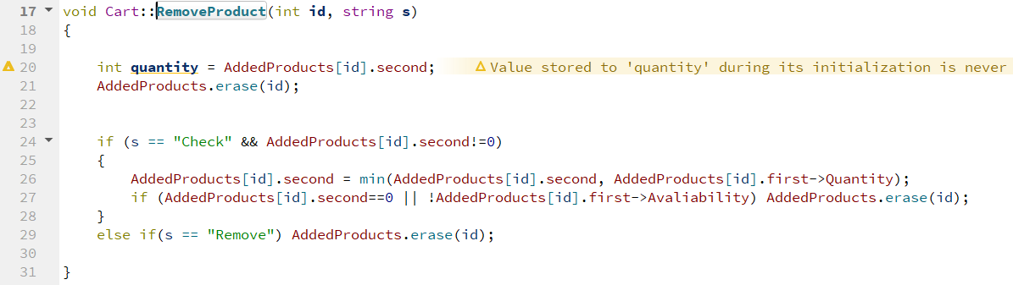
Remove Product

Slide 47
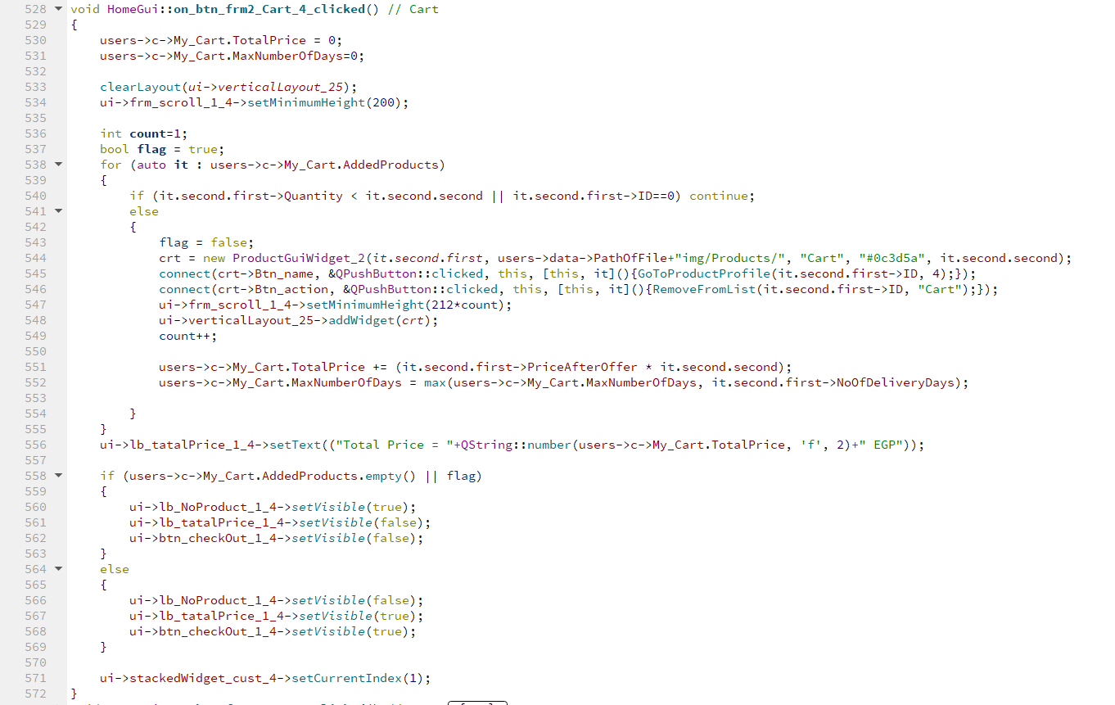
Cart page

Slide 48
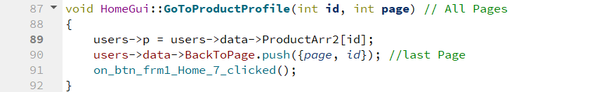
Product profile

Slide 49
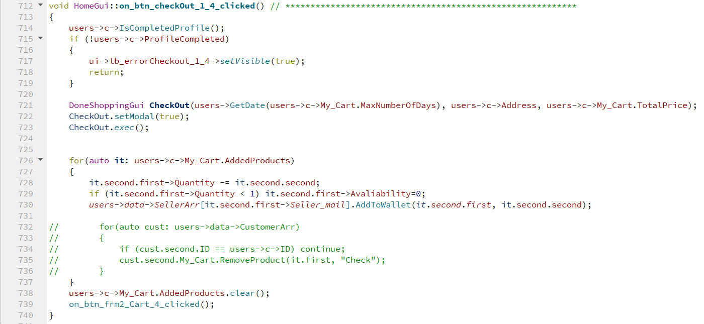
Check out

Slide 50
Seller page

Slide 51
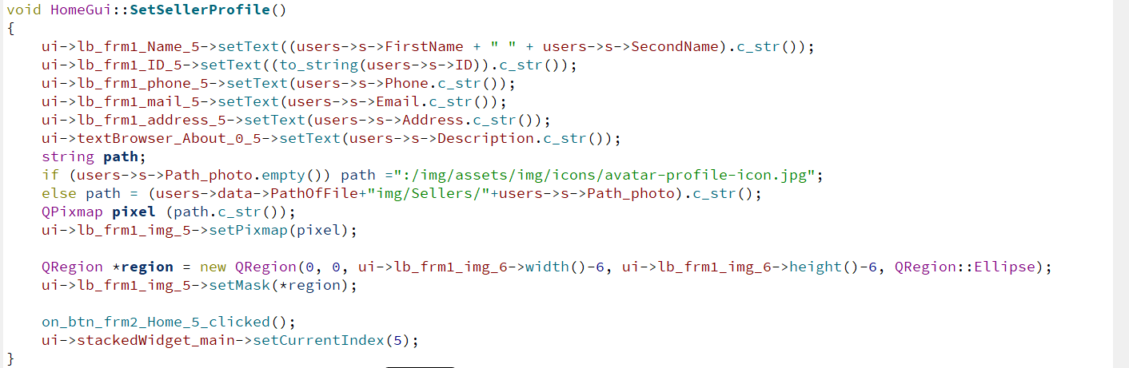

Slide 52
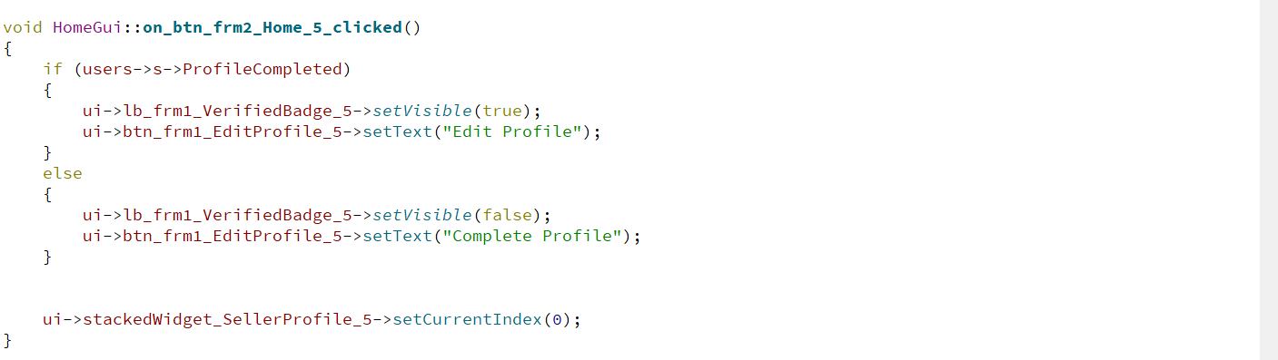

Slide 53
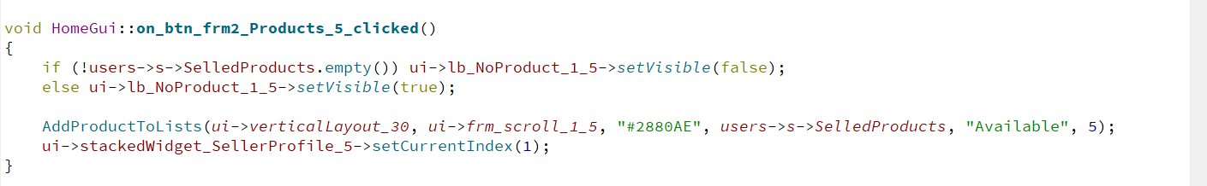

Slide 54
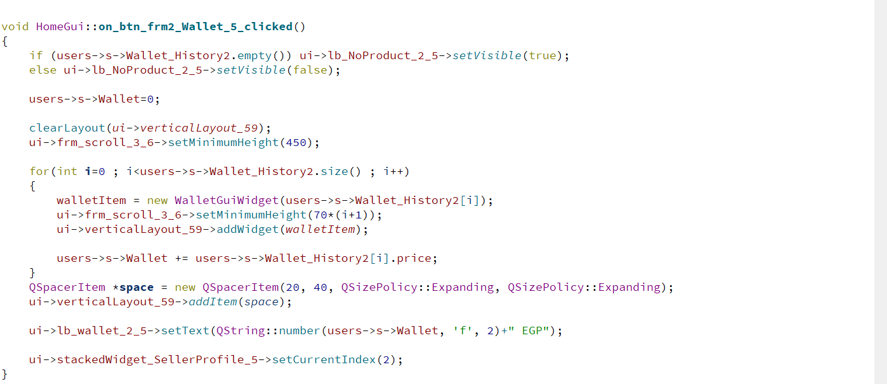

Slide 55
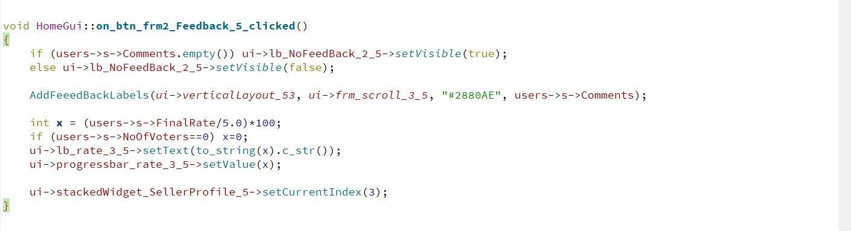

Slide 56
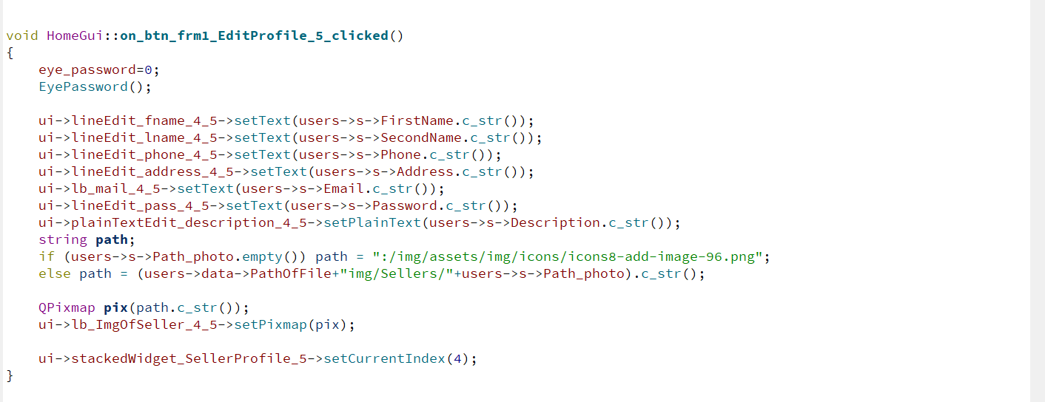

Slide 57
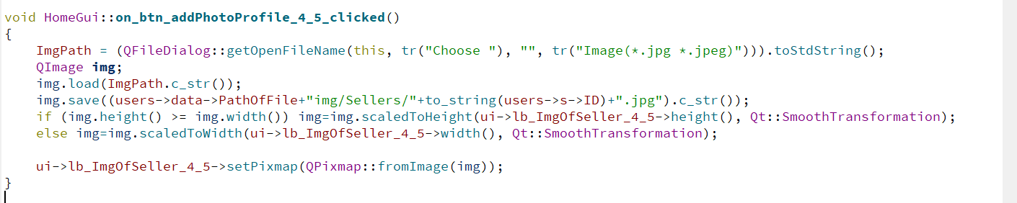

Slide 58
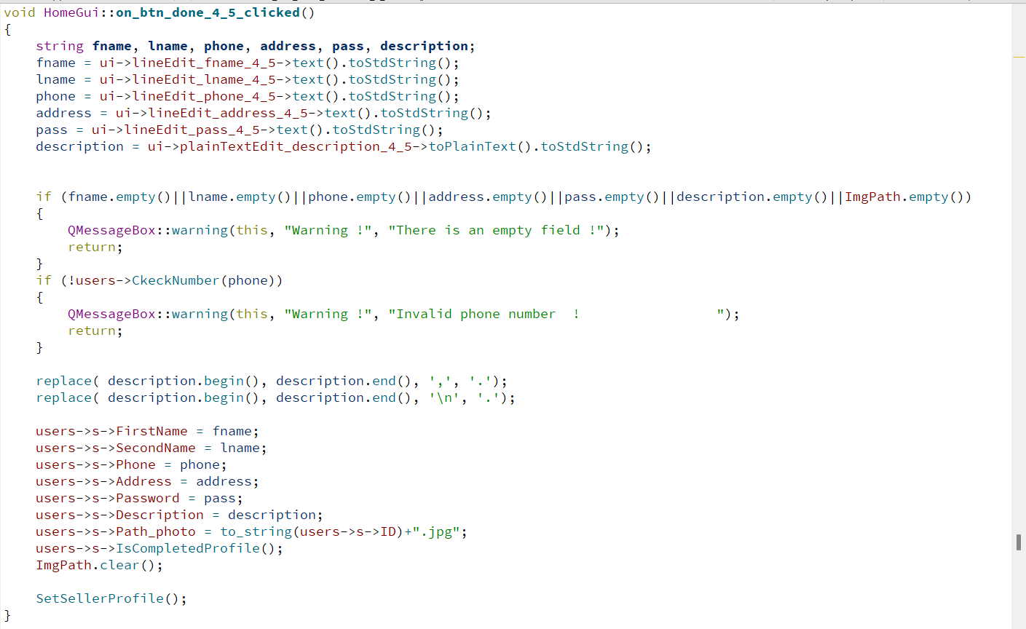

Slide 59


Slide 60


Slide 61


Slide 62


Slide 63


